Slide 1


Rental SYSTEM For Camera ACCESSORIES
Guided By:- Akshay Parab
Presented By:-Tushar Wahane
and Vinod Navale

Slide 2
CONTENTS
Features for Customers
Features for Shop Owner(Admin)

Slide 3
FEATURES for CUSTOMER
01
02
03
Register
Login
Edit Details
New Visitors Registration module
Customers Login module
Customers may Edit their details

Slide 4
FEATURES for CUSTOMER
04
05
06
Product Listings
Shopping Cart
Payment
Customer may check various product category list with products
Customer may select and add products to shopping cart
Different payment options at the time of checkout

Slide 5
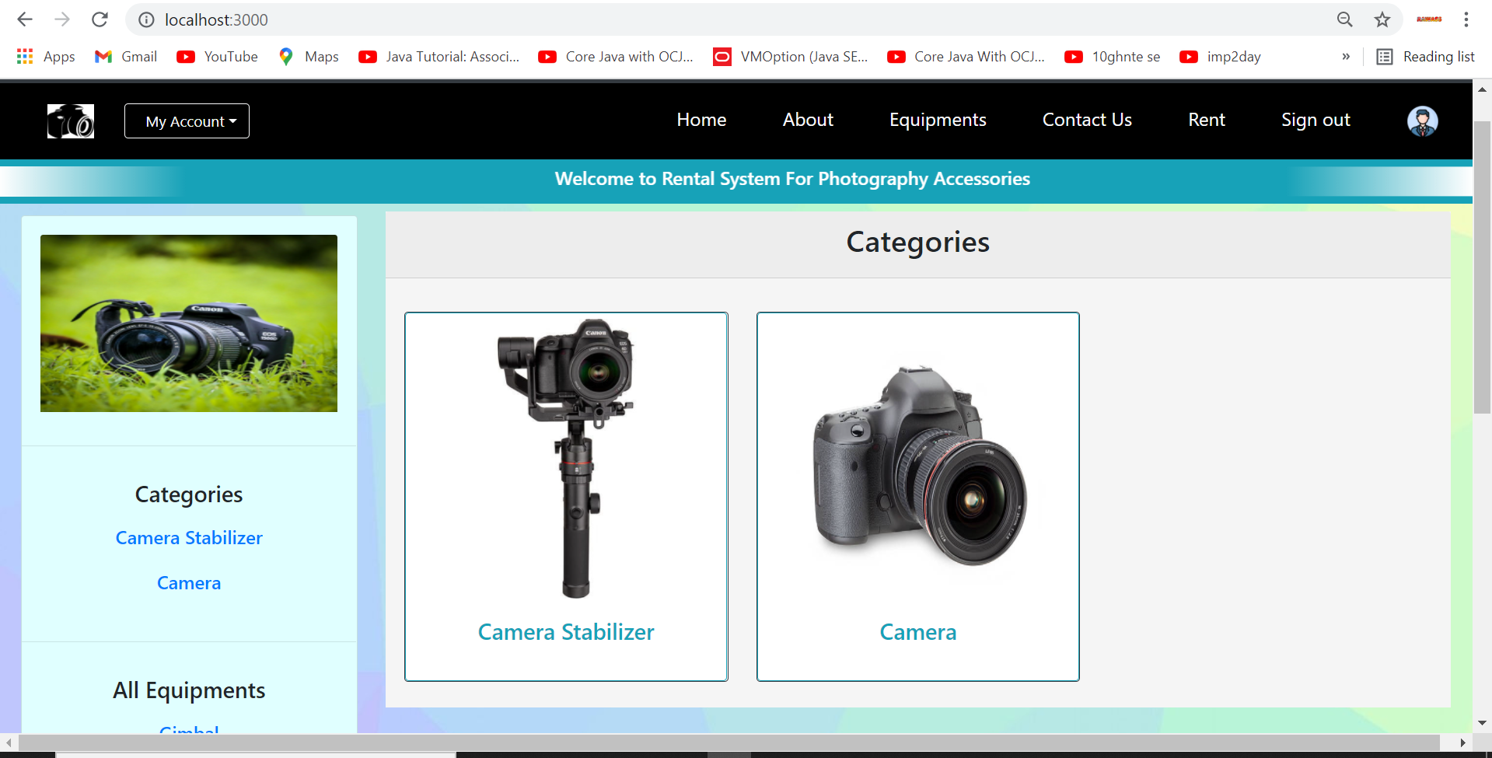
Homepage

Slide 6
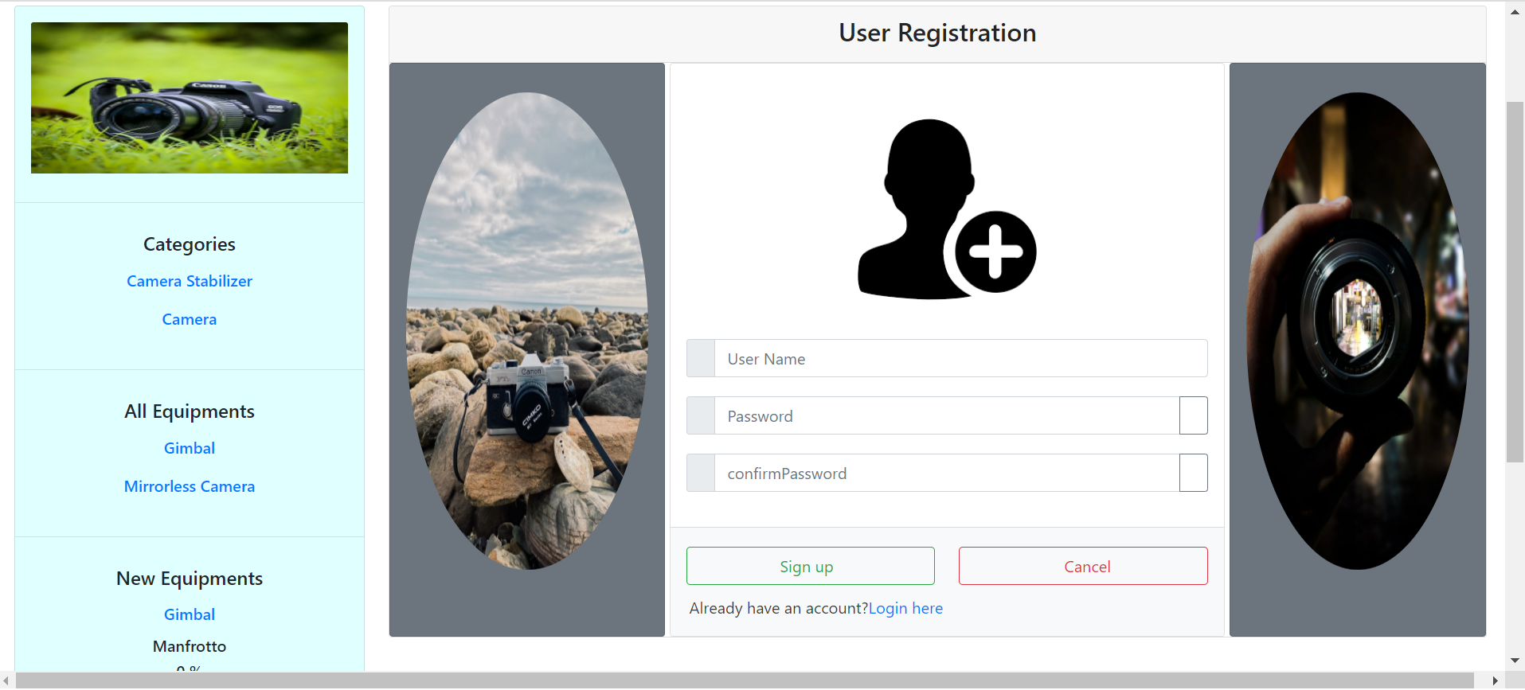
User Registration Page

Slide 7
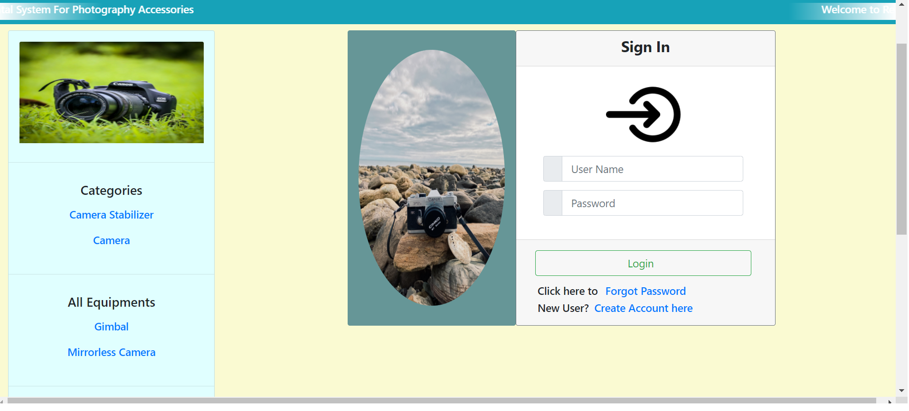
Login Page

Slide 8
FEATURES for OWNER(ADMIN)
01
02
03
Login
Profile
Managing users
Admin Login module
Admin Profile
Owner may manage users

Slide 9
FEATURES for OWNER(ADMIN)
04
05
06
Managing Categories
Managing Products
Managing Orders
Owner may manage their products categories
owner may manage products.
owner may manage orders.

Slide 10
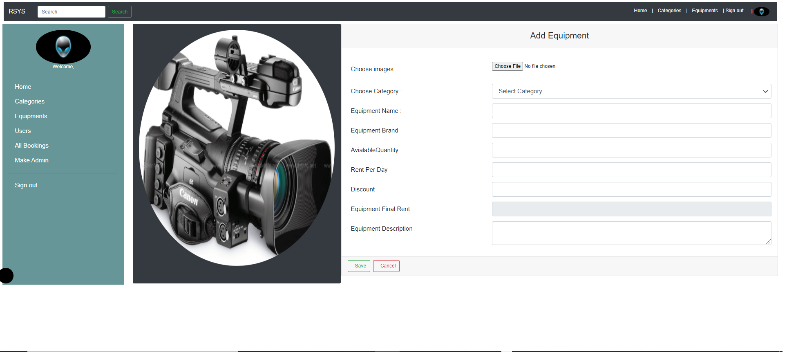
Admin Add Equipment page

Slide 11
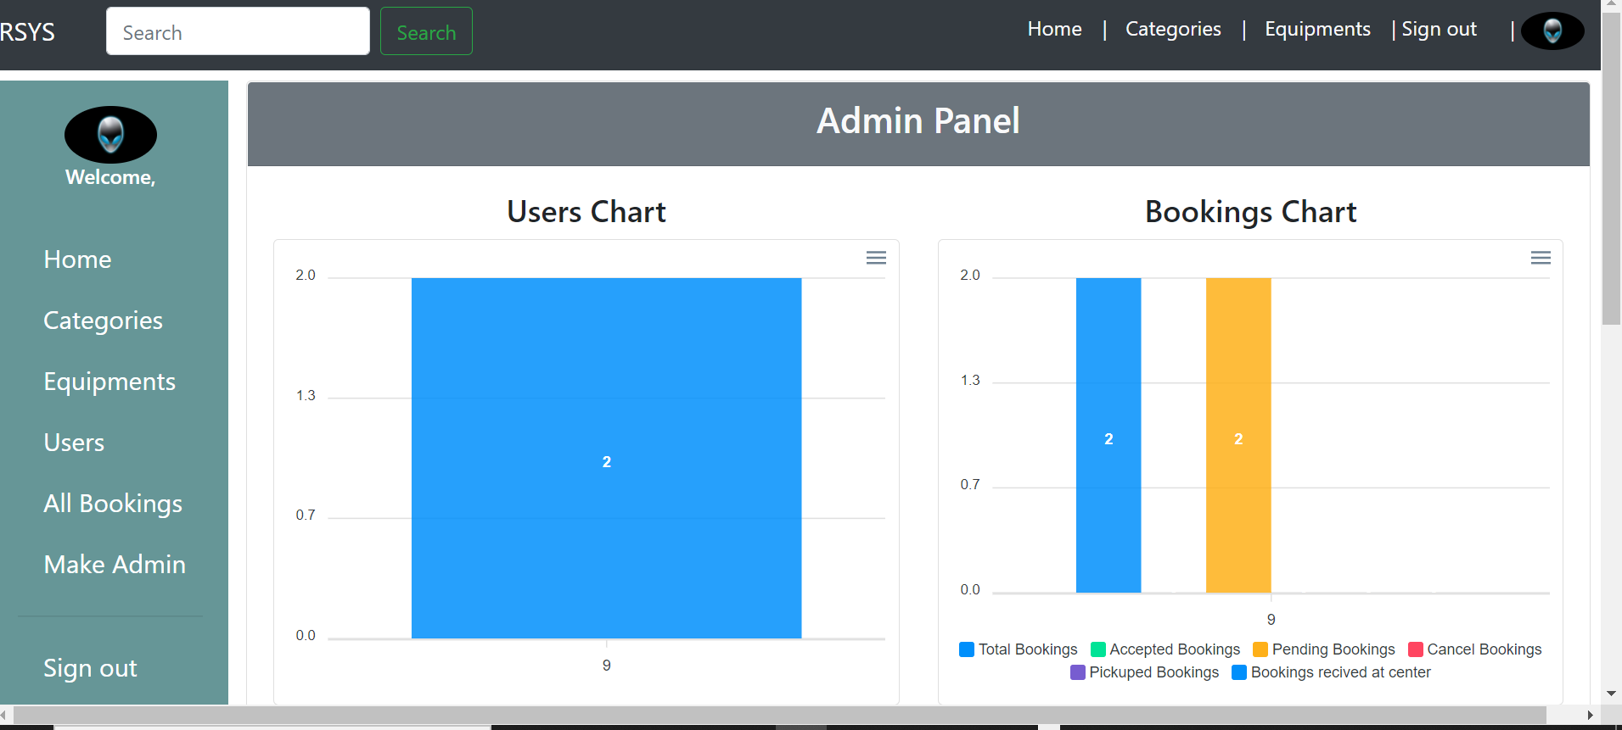
Admin Home Page

Slide 12
THANK YOU…!!!
~ Tushar & Vinod

